Slide 2
enzyme /ˈenzaɪm/
n. 酶
substrate/ˈsʌbstreɪt/
n. 底物
active site
活性位点
product /ˈprɒdʌkt/
n. 产物
optimum /ˈɒptɪməm/
adj. 最适宜的
denature /di'netʃər/
vi. 变性
Denaturation
catalase /ˈkætəˌleɪs/
过氧化氢酶
amylase /ˈæmɪleɪs/
n淀粉酶
pepsin/ˈpepsɪn/
n. 胃蛋白酶
trypsin/ˈtrɪpsɪn/
n. 胰蛋白酶
catabolism /kəˈtæbəlɪzəm/
n. 分解代谢
anabolism /əˈnæbəˌlɪzəm /
n. 合成代谢
complementary/ˌkɑːmplɪˈmentri/
adj. 互补的
Intracellular enzyme
/ˌɪntrəˈseljələr/
胞内酶
Extracellular enzyme
/ˌekstrəˈseljələr/
胞外酶

Slide 3
lock-and-key hypothesis |  | 锁钥学说
induced-fit hypothesis |  | 诱导契合学说
activation energy | /ˌæktɪˈveɪʃn/ | 活化能
inhibitor | /ɪnˈhɪbɪtər/ | 抑制剂
allosteric site | /ˌæləˈsterɪk/ | 变构位点
non-competitive inhibition |  | 非竞争性抑制
competitive inhibition |  | 竞争性抑制
End product inhibition |  | 终产物抑制
Michaelis–Menten constant（K_{m}） |  | 米氏常数
affinity | /əˈfɪnəti/ | 亲和力

Slide 4
Notes:
Teacher notes
In ‘Slide Show’ mode, click the name of a section to jump straight to that slide.

Slide 5

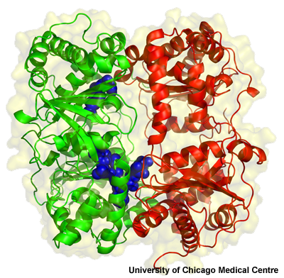

What are enzymes?
Every cell requires hundreds of biochemical reactions to survive and carry out its function.
Nearly all of these are catalyzed large globular proteins called enzymes.
Enzymes are biological catalyst can speed up reactions without changing the products by reducing the activation energy
Enzymes catalyze both anabolic (building up) and catabolic (breaking down) reactions.
Notes:
Photo credit: University of Chicago Medical Centre
Structure of human insulin-degrading enzyme (IDE) in complex with beta-amyloid, a peptide that forms harmful plaques in the brains of people with Alzheimer’s disease. The molecular surface of IDE is represented by light yellow. The N- and C-terminal domains of IDE are coloured green and red, respectively. The beta-amyloid (blue) is entrapped inside the degradation chamber of the IDE molecule.
Teacher notes
See the ‘Biological Molecules: Proteins and Lipids’ presentation for more information about the structure of proteins.
Some RNA molecules act as biochemical catalysts. These are called ribozymes.

Slide 6
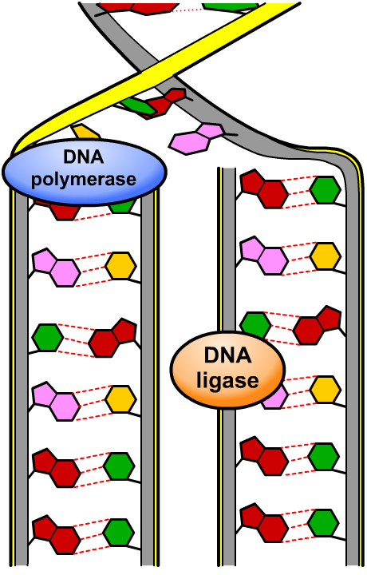
Location of enzyme action
Enzyme action occurs both intracellularly and extracellularly.
DNA replication is an intracellular process that involves many enzymes, such as DNA polymerase and DNA ligase.
The synthesis of ATP by ATPase during respiration, for example, occurs across the inner membrane of mitochondria.
Digestion involves the extracellular action of enzymes such as pepsin胃蛋白酶 and amylase淀粉酶. These break down food particles into small molecules, such as peptides and disaccharides.

Slide 7

Classification of enzymes
Notes:
Teacher notes
Catalase is another example of an oxidoreductase.

Slide 8
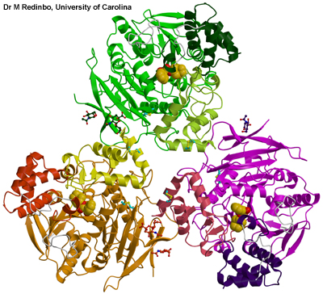
Structure of enzymes
All enzymes are globular proteins. They are soluble in water due to the presence of many hydrophilic side groups on their constituent amino acids.
Active site an area on an enzyme molecule where the substrate can bind
active site
The remainder of the amino acids maintain the precise shape of the enzyme and the active site.
Notes:
Photo credit: Dr M Redinbo, University of Carolina School of Medicine
Human carboxylesterase 1 (hCE1), a ‘bioscavenger’ enzyme involved in drug metabolism and detoxification, including that of cocaine and heroin. The largely yellow-coloured molecules rendered in CPK are the cocaine analogue homatropine. They are binding at the active sites of each enzyme monomer in the trimer. The other small molecules that appear to be floating are N-linked glycosylations attached to each enzyme monomer at Asn-79. In addition, there are two disulfide bonds (cyan and yellow) in each monomer.
More information about the therapeutic potential of hCE1 is available at http://www.unc.edu/news/archives/apr03/hce040703.html.
Teacher notes
See the ‘Biological Molecules: Proteins and Lipids’ presentation for more information about the structure of proteins.

Slide 9
Substrates and specificity
The active site of an enzyme binds the substrate molecule(s) of a biochemical reaction. A substrate is any substances that is acted upon by the enzyme.
Many enzymes are specific for just one reaction. For example, catalase过氧化氢酶 only catalyzes the breakdown of hydrogen peroxide, a toxic by-product of metabolism.
hydrogen peroxide
→
water
+
oxygen
catalase
H₂O₂
→
H₂O
+
O₂
Other enzymes catalyze more general types of reactions. For example, some lipases can break down different lipids into fatty acids and glycerol.
Notes:
peroxysome

Slide 10
Why do enzymes increase the rate?

Slide 11
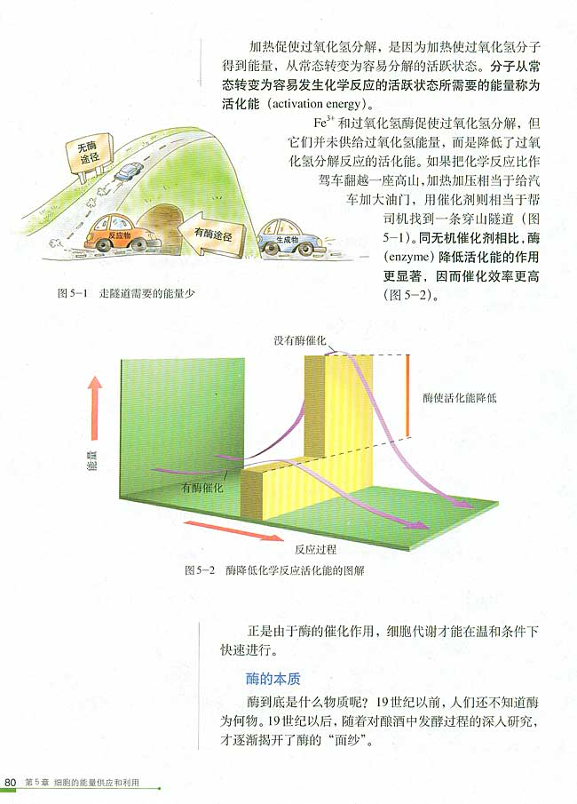
Notes:
汽车燃油相当于能量，这个过程中酶并没有给汽车增加油量，所以没有提供能量，只是降低反应门槛（过渡态）让反应变得更容易发生

Slide 12
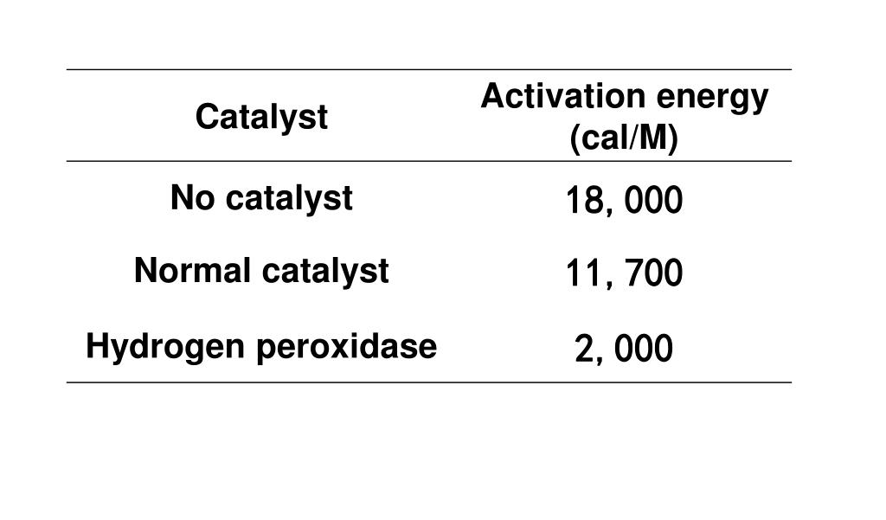
activation energy: the energy that must be provided to make a reaction take place; enzymes reduce the activation energy required for a substrate to change into a product

Slide 13
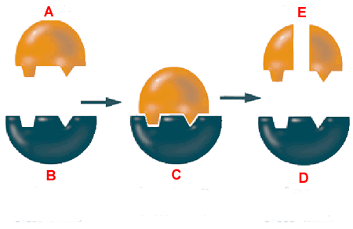
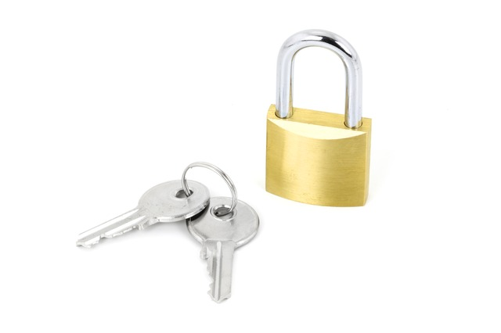
How enzymes work:
Substrate
Molecule has the exact shape for this particular enzyme
Products
Substrate broken down into smaller pieces
Substrate
Molecule to be broken down
Enzyme-substrate complex
A substrate fits exactly into the active site of the enzyme
Substrate
Active Site
Releases the products which no longer fit into the active site. Now free to bind with another substrate molecule，reuse
Active Site
Site shape matches that of the substrate
Active Site
Location on enzyme where reaction occurs
Extension:
What does this mechanism remind you of?
Enzyme

Slide 14
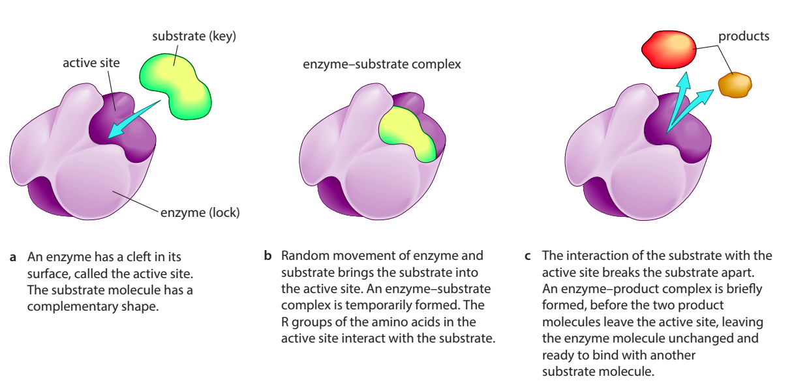

Slide 15
Models of enzyme action: lock-and-key
Notes:
Teacher notes
This reaction involves the breakdown of a single substrate molecule into two product molecules, so it is an example of a catabolic reaction.

Slide 16
Models of enzyme action: induced fit
Notes:
Teacher notes
As the enzyme and substrate bind, it is possible that bonds in the substrate become stretched or strained, stabilizing the transition state of the substrate, which lowers the activation energy and enables bonds to be broken more easily.
This reaction involves the breakdown of a single substrate molecule into two product molecules, so it is an example of a catabolic reaction.

Slide 17
Characteristics of enzymes
specificity
reuse
high efficiency

Slide 18
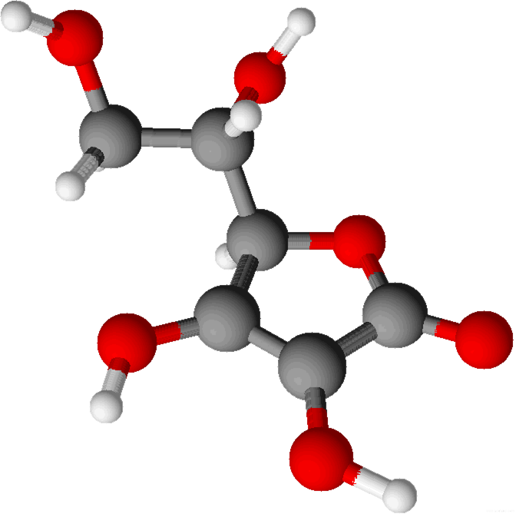
What are cofactors?
Some enzymes require the addition of a non-protein substance called a cofactor before they can catalyze a reaction. There are two main types of cofactor:
activators – inorganic groups that are permanently bound to the enzyme and so are a type of prosthetic group. Common examples include iron, zinc and copper.
coenzymes – organic molecules that bind only temporarily to the enzyme, transferring a chemical group necessary required for the reaction. Examples include vitamin C and ATP.
vitamin C
Notes:
Teacher notes
Image shows the 3D structure of vitamin C (ascorbic acid), C₆H₈O₆.
Many trace elements, required in the diet in very small quantities, are enzyme activators.
Many vitamins and their derivatives are coenzymes, such as:
niacin (B₃) – converted into the coenzyme NAD⁺ and NADP⁺
pantothenic acid (B5) – converted into the coenzyme coenzyme A
vitamin K – converted into the coenzyme menaquinone.

Slide 19
Enzymes: true or false?

Slide 20
Notes:
Teacher notes
In ‘Slide Show’ mode, click the name of a section to jump straight to that slide.

Slide 21
Measuring the initial rate of reaction
Notes:
初始速率是最快的，在0处画切线，选择适当时间，计算出初始速度

Slide 22
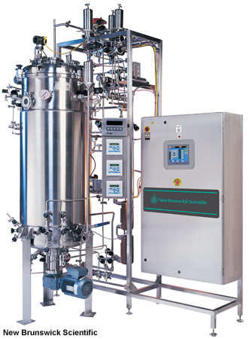
What factors affect enzymes?
The rate of an enzyme-controlled reaction is affected by several factors:
temperature
pH
enzyme concentration
substrate concentration.
Each enzyme works best within a range of conditions, and this range is different for each enzyme.
Enzymes are also affected by the presence of inhibitors.
Notes:
Photo credit: New Brunswick Scientific
A BioFlo™ Pro fermentor from New Brunswick Scientific, Edison NJ, USA. www.nbsc.com
Teacher notes
A fermentor, such as the one in the image, is a vital piece of equipment in the industrial use of enzymes as it makes it relatively easy to monitor and maintain optimum conditions.

Slide 23
Effect of temperature on enzymes
Notes:
Teacher notes
Students could be asked if they can deduce the equation for calculating the Q₁₀ of this reaction based on the data from this graph.
Q₁₀ = rate of reaction at x + 10 °C / rate of reaction at x °C

Slide 24
Effect of pH on enzymes

Slide 25
Rate of reaction experiment

Slide 26
Effect of substrate concentration on rate

Slide 27
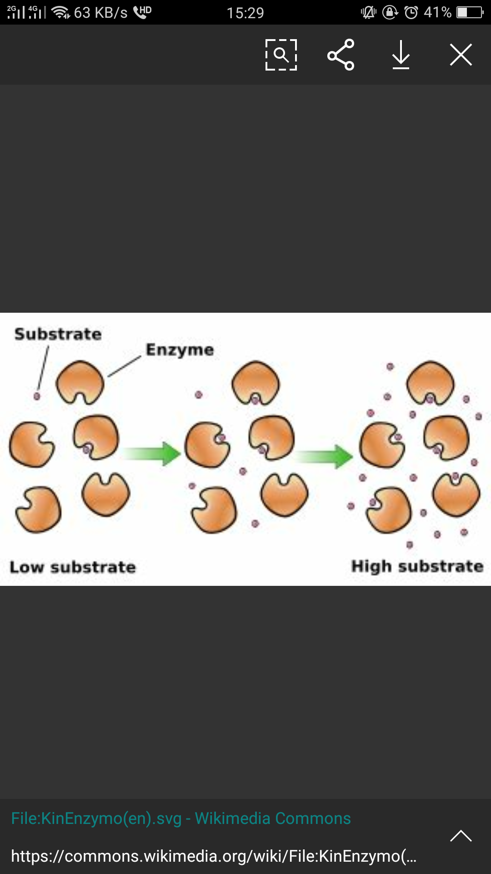
Rate of reaction of an enzyme reaction changes at substrate and enzyme concentrations

Slide 28
Effect of enzyme concentration on rate

Slide 29
Factors affecting rate of reaction

Slide 30
Notes:
Teacher notes
In ‘Slide Show’ mode, click the name of a section to jump straight to that slide.

Slide 31
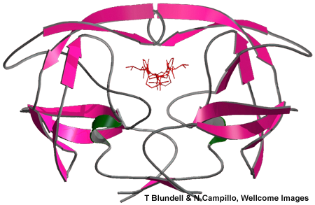
What are enzyme inhibitors?
Substances can interfere with enzyme activity are called inhibitors. They can be classed in two ways, depending on their mode of action:
Inhibitors can be either competitive (active site directed) or non-competitive (non-active site directed), depending on whether they compete with the substrate for binding at the active site or not.
Inhibitors can be either reversible or irreversible, depending on whether their inhibitory effect on the enzyme is permanent or not.
Notes:
Photo credit: T Blundell & N Campillo, Wellcome Images
Molecular model of HIV proteinase (the large pink and grey structure) complexed with an inhibitor (small, red molecule).

Slide 32
Reversible inhibition that dissociate very rapidly from enzyme because it becomes very loosely bound with the enzyme.
An irreversible inhibitor separates very slowly from its target enzyme because it becomes very tightly bound to its active site while inactivating the enzyme molecule.

Slide 33
Enzyme inhibitors: mode of action
Notes:
酶的变构调节是指小分子化合物与酶蛋白分子活性位点以外的某一部位特异结合，引起酶蛋白分子构象变化、从而改变酶的活性
https://thebiologynotes.com/enzyme-inhibitors/

Slide 34
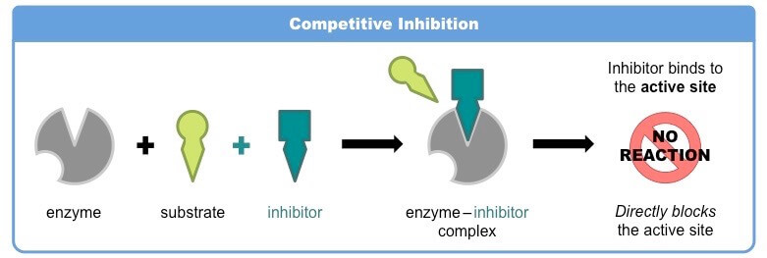
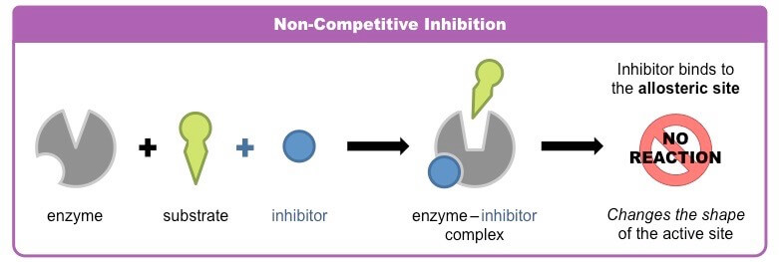

Slide 35
Effect of inhibitors on enzymes

Slide 36
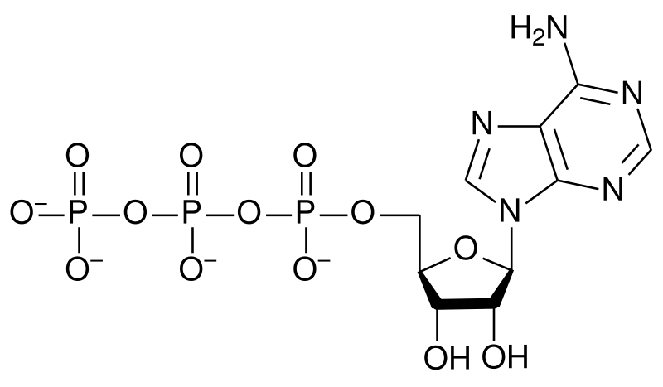
End-product inhibition
Enzyme inhibition is important in regulating metabolic pathways. The final (end) product often acts as a regulator of the pathway in a process called end-product inhibition.
When the amount of end product is high, it binds non-competitively to an enzyme in the pathway, blocking further production of itself.
When the amount of end product falls, inhibition ends and the pathway restarts.
The synthesis of ATP is regulated in this way, with ATP acting as the inhibitor.
Notes:
Teacher notes
End-product inhibition is an example of negative feedback.

Slide 37
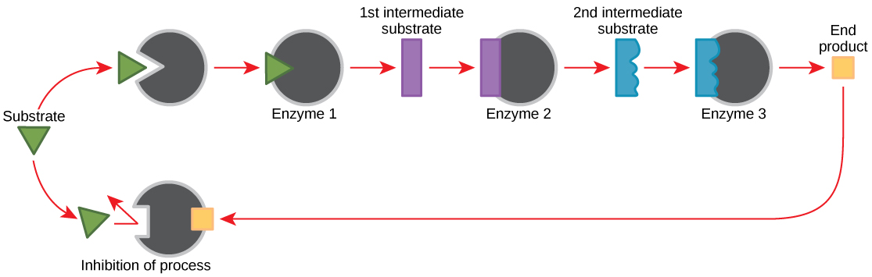
End-product inhibition
The end product inhibits the enzyme at the beginning
of the chain of reactions
End product is non-competitive, reversible inhibitor

Slide 38
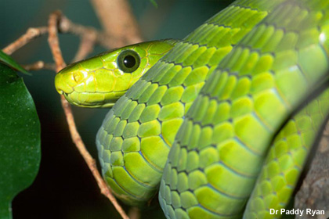
Uses of inhibitors: natural poisons
Many natural poisons are enzyme inhibitors.
Inhibitors in toxins/venom can irreversibly block enzymes such as acetylcholinesterase, causing paralysis and death.
Heavy metals such as mercury and cadmium are irreversible non-competitive inhibitors, blocking a range of metabolic reactions.
Cyanide is an irreversible inhibitor of an enzyme involved in respiration, preventing cells from producing ATP.
Notes:
Photo credit: Dr Paddy Ryan / Ryan Photographic
A green mamba (Dendroaspis angusticeps), whose venom contains fasciculin, a potent inhibitor of acetylcholinesterase. www.ryanphotographic.com
Teacher notes
Toxin: a poisonous substance produced by a living organism. Many toxins are not enzyme inhibitors but work by interfering with cell receptors and ion channels.
Venom: a toxin produced by an animal that is injected into its prey to cause paralysis and/or death. Used as a defence mechanism or for predation. Venom can contain many different types of toxin.
Poisonous organism: an organism that is harmful if eaten or touched (distinct from a venomous organism).
Glycoalkaloids are acetycholinesterases produced by some members of the Solanaceae family of flowering plants (includes the deadly nightshade, potatoes and tomatoes).
/əˈsiːtaɪlˌkəʊliːnˈestərˌeɪz/

Slide 39
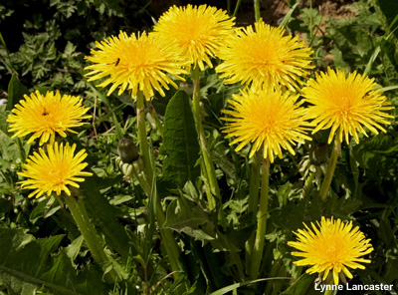
Uses of inhibitors: biocides
Biocides are chemicals that can kill a living organism, and are commonly used in agriculture, the food industry and medicine. Many are enzyme inhibitors.
For example, the insecticide malathion irreversibly inhibits acetylcholinesterase, while the common herbicide glyphosate草甘膦 blocks the synthesis of amino acids.
Triclosan三氯生 is an antibacterial/antifungal disinfectant that inhibits an enzyme involved in fatty acid synthesis. It is used in toothpaste, soaps and other cleaning products.
Notes:
Photo credit: Lynne Lancaster
Teacher notes
Biocides are classed into four main groups by the European Community:
1. Disinfectants and general biocidal products, e.g. for human/veterinary hygiene, food/drink disinfectants
2. Preservatives, e.g. for food, wood, fibres, leather
3. Pest control e.g. rodenticides, insecticides
4. Other biocidal products, e.g. antifouling products, embalming/taxidermist fluid
三氯生广泛应用于高效药皂/卫生香皂、卫生洗液、除狐臭/脚气雾剂、消毒洗手液、伤口消毒喷雾剂、医疗器消毒剂、卫生洗面奶/膏、空气清新剂及冰箱除臭剂等，也用于卫生织物的整理和塑料的防腐和处理，更高纯度的三氯生还广泛用于治疗牙犁炎、牙周炎及口腔溃疡等疗效牙膏及漱口水中，建议使用浓度为0.05%-0.3%。

Slide 40
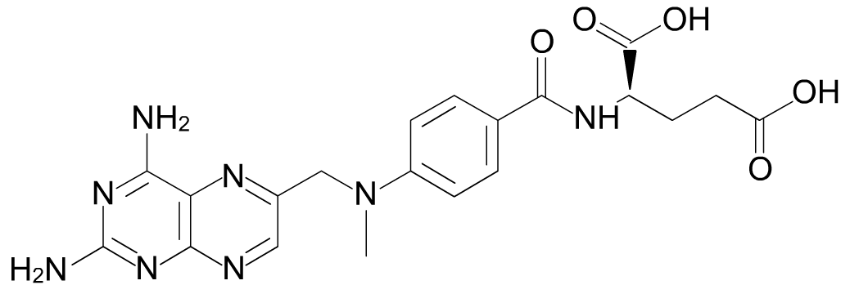
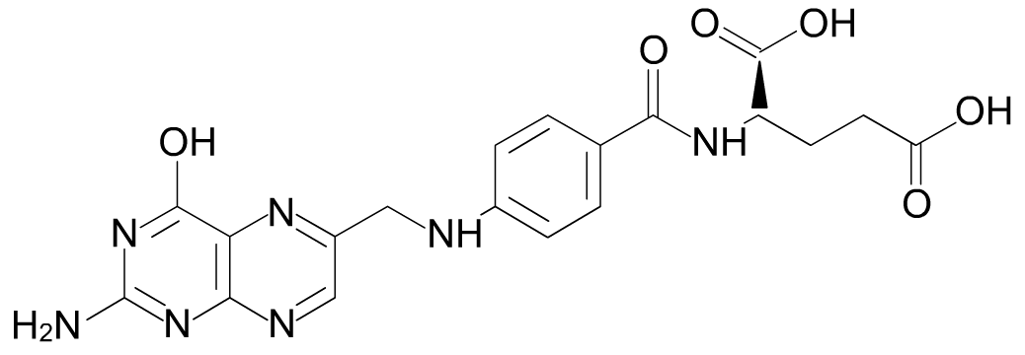
Uses of inhibitors: drugs
The antibiotics penicillin and vancomycin万古霉素 inhibit enzymes involved in the production of bacterial cell walls.
Methotrexate is used in the treatment of cancer and some autoimmune diseases. It inhibits the enzyme dihydrofolate二氢叶酸 reductase, which is involved with the metabolism of follic acid叶酸.
methotrexate
甲氨蝶呤
folic acid
Do you think methotrexate is a competitive or non-competitive inhibitor of the enzyme?
It is competitive and reversible.
Notes:
Teacher notes
Other enzyme inhibitors include:
protease inhibitors and reverse transcriptase inhibitors – used in the treatment of HIV
acetylcholinesterase inhibitors – used in the treatment of Alzheimer’s disease and myasthenia gravis (a neuromuscular disease)
sildenafil (Viagra) – used in the treatment of erectile dysfunction.
New enzyme inhibitor drugs can be developed in two ways:
a huge number of structurally-similar compounds are created (by combinatorial chemistry) and tested for their inhibitory effects (by high-throughput screening)
atudying the 3D structure of an enzyme’s active site and predicting what type of molecule might be an inhibitor with the aid of computers.
/ˌmeθəʊˈtrekseɪt/

Slide 41
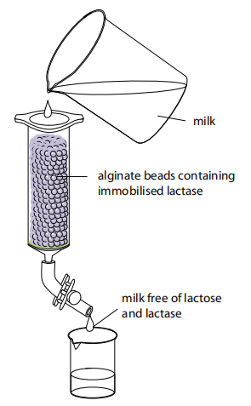
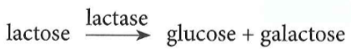
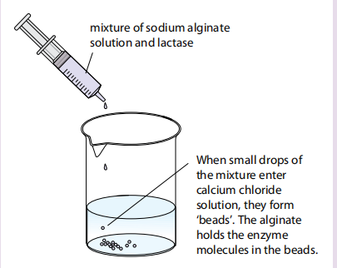
Immobilised enzymes
syringe barrel 针管
sodium alginate海藻酸钠
lactose-reduced milk
降乳糖牛奶
immobilised enzymes: enzymes that have been fixed to a surface or trapped inside beads of agar gel琼脂
The enzyme is mixed with a solution of sodium alginate.
then added to a solution of calcium chloride.
droplet into a little bead.
As the substrate runs over the surface of the beads
enzymes catalyse a reaction
The product can be collected and purified.
Notes:
Figure 3.15 shows one way in which enzymes can
be immobilised. The enzyme is mixed with a solution
of sodium alginate. Little droplets of this mixture are
then added to a solution of calcium chloride. The sodium
alginate and calcium chloride instantly react to form jelly,
which turns each droplet into a little bead. The jelly bead
contains the enzyme. The enzyme is held in the bead, or
immobilised.
These beads can be packed gently into a column. A liquid
containing the enzyme’s substrate can be allowed to trickle
steadily over them (Figure 3.16).
As the substrate runs over the surface of the beads, the
enzymes in the beads catalyse a reaction that converts the
substrate into product. The product continues to trickle
down the column, emerging from the bottom, where it can
be collected and purified.

Slide 42
Advantages of immobilised enzymes
1) enzyme is reused
2) enzyme is easily recovered回收
3) product isn’t contaminated with enzymes
4) reduces product inhibition
5) enzyme is more stable/less likely to denature
6) longer shelf-life of enzyme

Slide 43
Enzyme inhibitors: what binds where?
Notes:
Teacher notes
Students could be informed that shapes C and D fit together to form shape B, and are therefore products of the catabolism of B.

Slide 44
Measuring the initial rate of reaction
Notes:
初始速率是最快的，在0处画切线，选择是当时时间，计算出初始速度

Slide 45
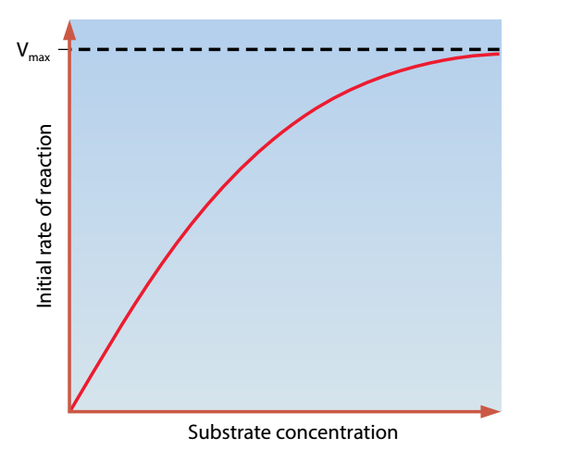
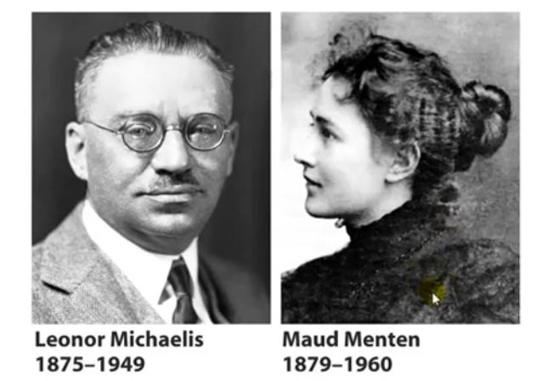
Michaelis-Menten Equation(米氏方程)
The initial rate for each substrate concentration is plotted against substrate concentration.
This curve is asymptotic ([,æsɪmp'tɒtɪk] 渐进的).
In particular, the curve never completely flattens out (变平)in practice.
Notes:
在V最大时，所有的酶分子都与底物分子结合酶被底物饱和。所有活跃的站点都已满。V max的测量方法如图3.11b所示。在保持酶浓度不变的情况下，测定不同底物浓度下反应的初始速率。随着底物浓度的增加，反应速率逐渐增大，直至达到最大速率V max

Slide 46
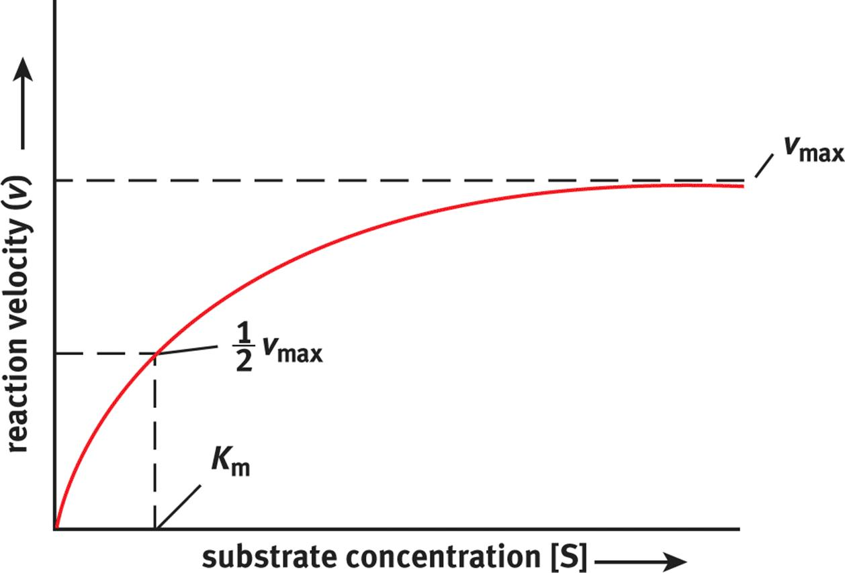
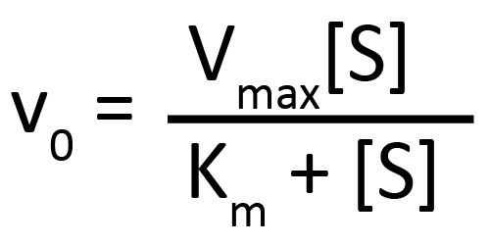
A plot of V vs [S] is often hyperbolic(双曲线的).
Called a Michaelis-Menten plot(米氏曲线)
K_{m} (Michaelis-Menten constant)=½Vmax
• the substrate concentration at which enzyme works
at half its maximum rate
a measure of the affinity of the enzyme for its substrate.
V=1/2 V_{max ，}K_{m}=[S]
Notes:
米氏常数-意义 它的意义如下： 它的数值等于酶促反应达到其最大速度Vm一半时的底物浓度〔S〕，图示以及公式推导。 它可以表示酶和底物之间的亲和能力，Km值越大，亲和能力越弱，反之亦然。 它可以确定一条 代谢途径 中的 限速步骤 ：代谢途径是指由一系列彼此密切相关的 生化反应 组成的 代谢 过程，前面一步反应的产物正好是后面一步反应的底物，例如，EMP途径。 限速步骤就是一条代谢途径中反应最慢的那一步，Km值最大的那一步反应就是，该酶也叫这条途径的关键酶。 它可以用来判断酶的最适底物，某些酶可以 催化 几种不同的生化反应，叫 多功能酶 ，其中Km值最小的那个反应的底物就是酶的最适底物。

Slide 47
K_{m}=[S] at 1/2 V_{max}
affinity：
is a measure of the strength of attraction between the
enzyme and its substrate. The greater the affinity of an
enzyme for its substrate, the faster it works
Km is larger，the lower the affinity，the lower the substrate concentration，the lower the Vmax
lower Km，the lower the substrate concentration, the the higher the affinity，the higher the Vmax

Slide 48
The significance of V_{max} and K_{m} values
Make computerised models of biological pathways or even the behaviour of whole cells.
An enzyme preference for different substrated can be compared quantitatively.
Design better catalysts.
The performance of the same enzyme from different organisms can be compared.
………

Slide 49
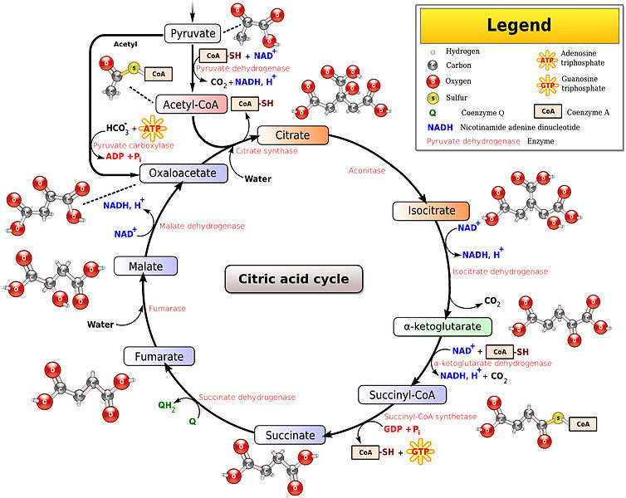

Slide 50
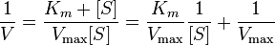
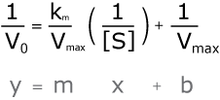
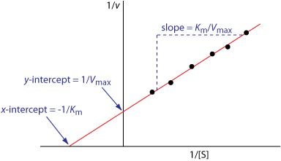
Double-reciprocal plot双倒数作图
Instead of plotting substrate concentration, [S], on the x-axis and velocity (rate) on the y-axis, we can plot 1/[S] (the inverse of substrate concentration) and 1/v (the inverse of velocity) respectively.

Slide 51
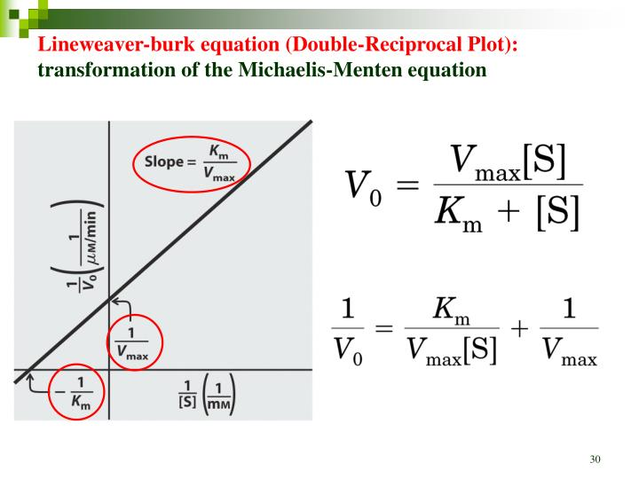
How can we find K_{m} from a double-reciprocal plot?

Slide 52
The point where the line of the graph intersects the x-axis is -1/K_{m} (note that it is in the negative region of the x-axis).
From the value for -1/K_{m}, we can calculate K_{m}.
The value of K_{m} depending on a number of factors:
Identity of the substrate
Temperature, pH,
Presence of particular ions, overall ion concentration, and the presence of poisons, pollutants or inhibitors.

Slide 53
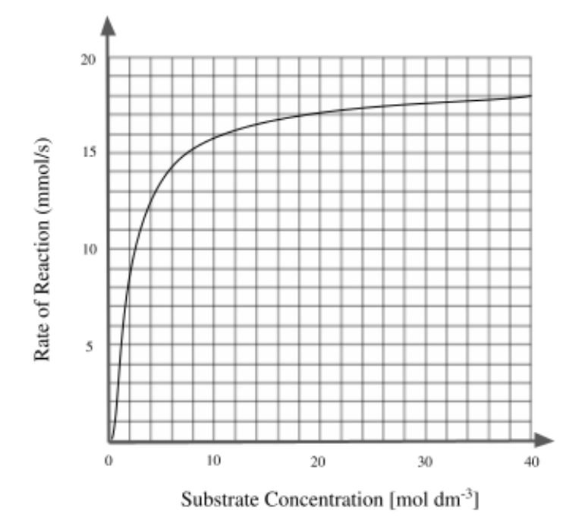
Based on the Reaction Velocity vs. Substrate Concentration graph below, identify the Vmax for this reaction.
9 mmol/s
18 mmol/s
40 mol dm^-3
2 mol dm^-3
Notes:
b

Slide 54
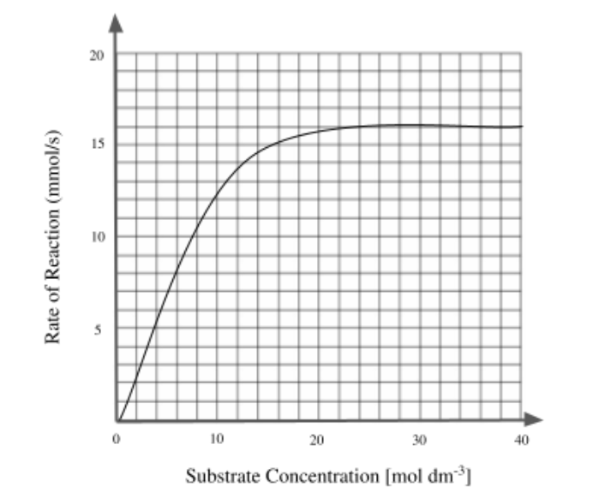
The graph below depicts Reaction Velocity vs. Substrate Concentration, identify the Km for this reaction.
6 mol dm^-3
40 mol dm^-3
8 mmol/s
16 mmol/s
Notes:
c

Slide 55
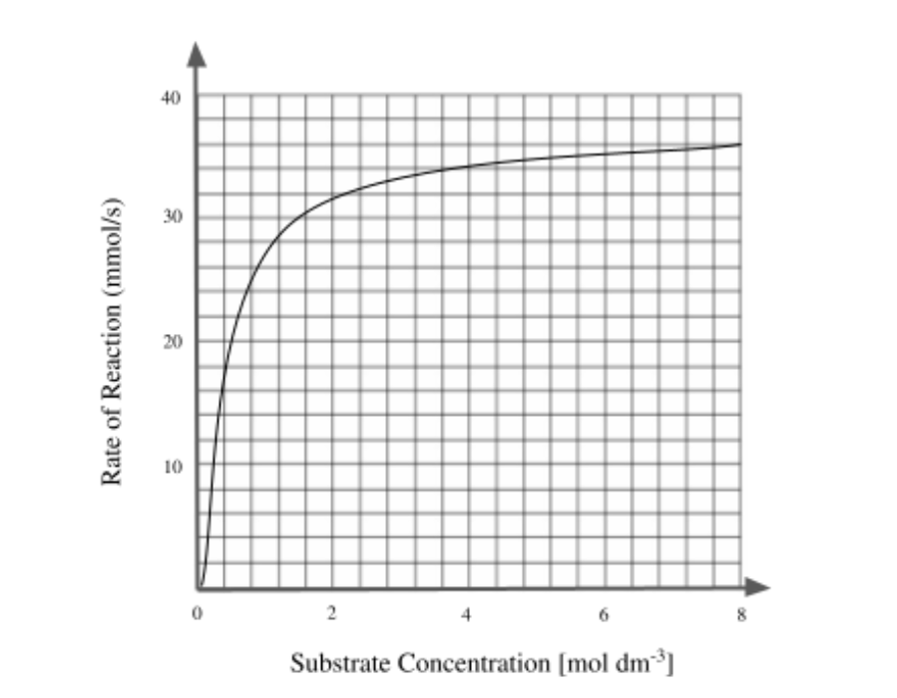
Based on the Reaction Velocity vs. Substrate Concentration graph below, select the correct statements.
1. Vmax of the reaction is 36 mmol/s
2. Km of the reaction is 0.4 mol dm^-3
3. Km is the value on x-axis that intercepts with Vmax
Notes:
1.2
3.km是x轴上与1/s的截距

Slide 56
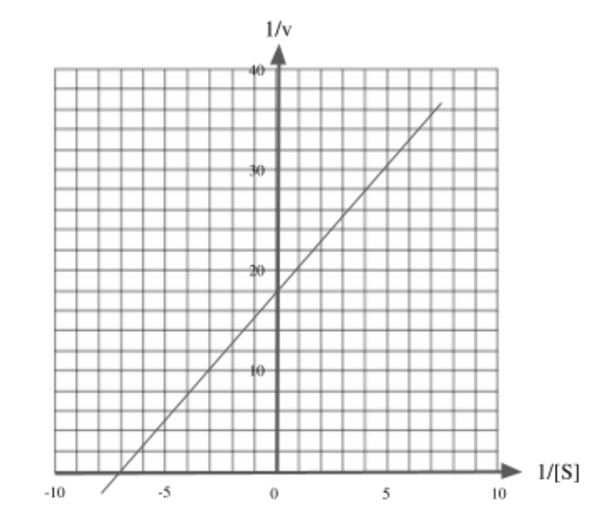
Based on Lineweaver-Burk plot below, identify Km(mol/dm^3) and Vmax(mmol/s) of the reaction
18 mol/dm^3 ; 7 mmol/s
1/7 mol/dm^3 ; 1/18 mmol/s
1/18 mol/dm^3 ; 1/7 mmol/s
7 mol/dm^3 ; 18 mmol/s
Notes:
-1/km=-7 km=1/7 1/vmx=18 vmax=1/18 B

Slide 57
Exercise
Two inhibitors of the same enzyme, inhibitor A and inhibitor B, were investigated to discover if they were competitive or non-competitive. In order to do this, the rate of reaction of the enzyme was measured at different concentrations of substrate without inhibitor, with inhibitor A and with inhibitor B. Graphs of the data were plotted as shown on the next page. The graphs showed that one inhibitor was competitive and the other non-competitive.

Slide 58
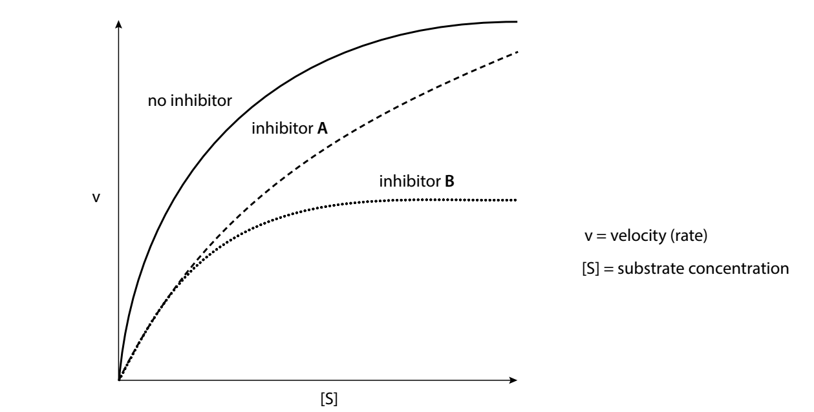
1. Label the graph for ‘no inhibitor’ to show the position of V_{max}, ½V_{max} and K_{m}.
2.State the effect that inhibitor A had on V _{max} and K_{m} of the enzyme.
3. State the effect that inhibitor B had on V _{max} and K_{m} of the enzyme.
4.Which inhibitor is competitive and which is non-competitive? Explain your answer.
Notes:
A：vmax 不变，km变大，competitive
B：vmax变小，km不变，non-competitive

Slide 59
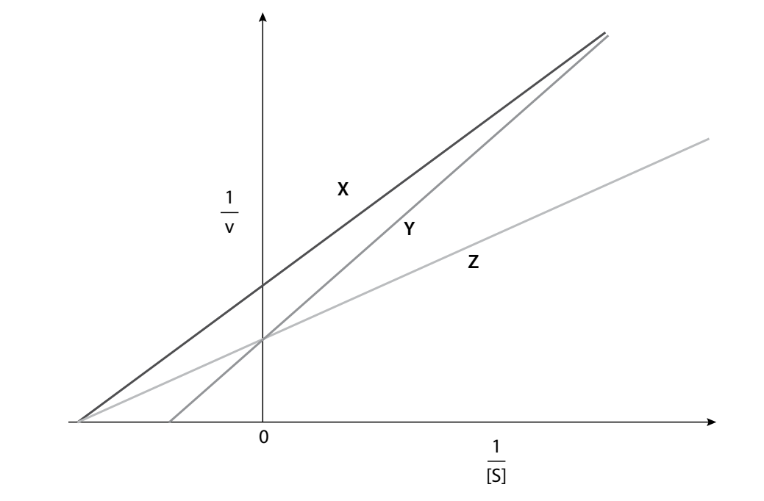
Double-reciprocal plots of the data obtained produced the following graphs.
5. Identify which line, X, Y or Z, corresponds to each of the following experiments:
i. inhibitor absent
ii. competitive inhibitor present
iii non-competitive inhibitor present
Briefly explain your answers to ii and iii.

Slide 60
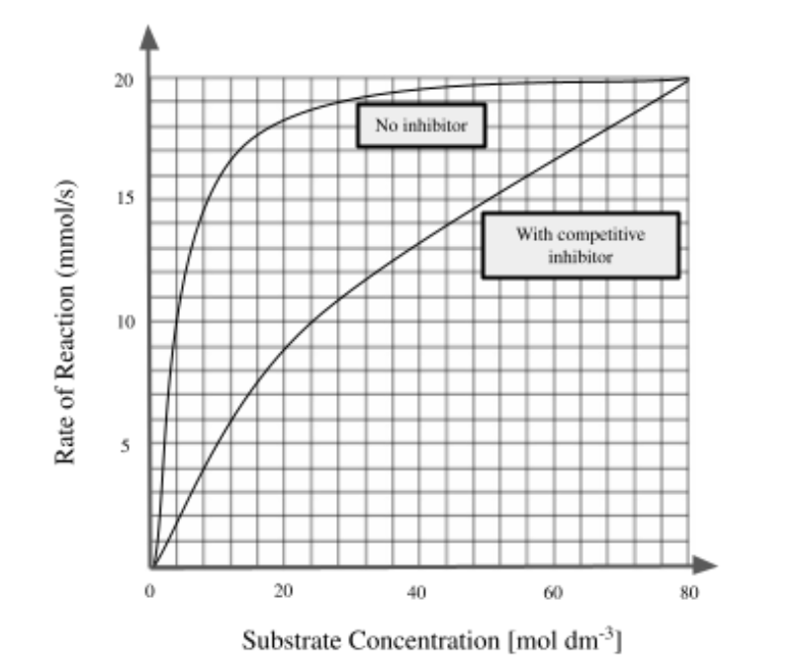
The graph below shows how the rate of an enzyme-catalysed reaction is affected when competitive inhibitors are added. Calculate Km and Vmax for the reaction affected by competitive inhibitors.
20 mol/dm^3 ; 4 mmol/s
20 mol/dm^3 ; 24 mmol/s
24 mol/dm^3 ; 20 mmol/s
4 mol/dm^3 ; 20 mmol/s
Notes:
B

Slide 61
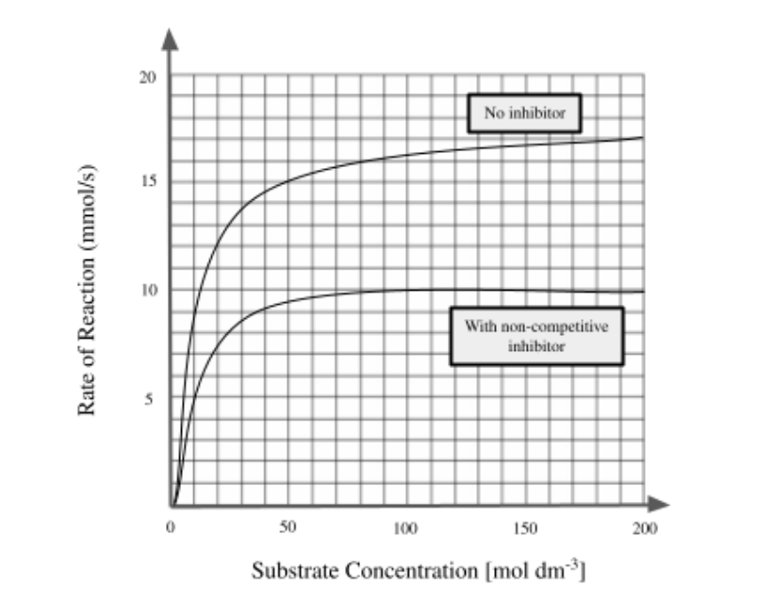
The graph below shows how the rate of an enzyme-catalysed reaction is affected by non-competitive inhibitors. Calculate Km and Vmax for the reaction affected by non-competitive inhibitors.
10 mol/dm^3 ; 10 mmol/s
5 mol/dm^3 ; 17 mmol/s
5 mol/dm^3 ; 10 mmol/s
10 mol/dm^3 ; 8.5 mmol/s
Notes:
A

Slide 62
Based on first questions, which of the following statements correctly describes the effect of inhibitors on an enzyme-catalysed reaction?
I. Non-competitive inhibitors does not affect the affinity of enzymes
II. Competitive inhibitors decreases the affinity of enzymes
III. The effect of competitive inhibitors on enzyme can be overcome with more substrates
IV. The effect of non-competitive inhibitors on enzyme can be overcome with more substrates
I, II and III
I, III and IV
I, II, III and IV
II, III and IV
Notes:
A

Slide 63
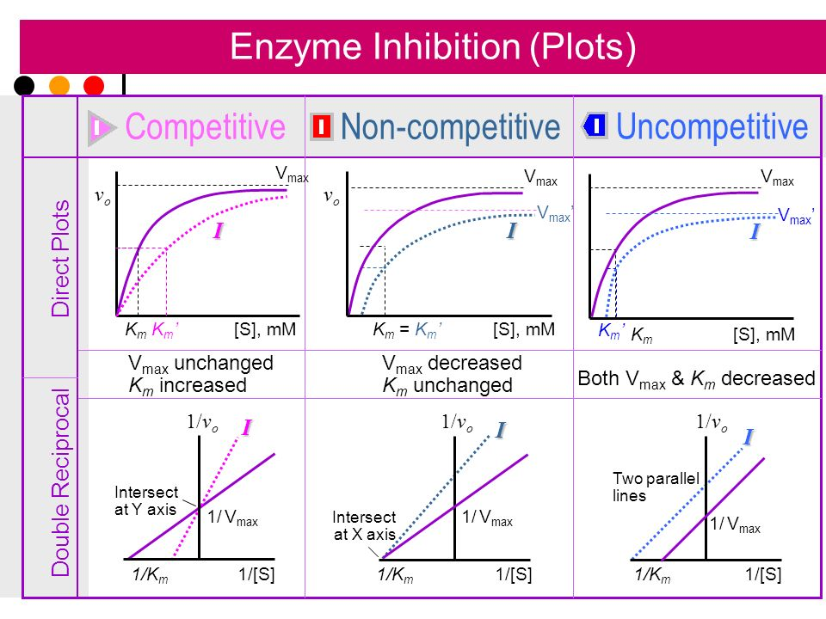
Notes:
中文名反竞争性抑制
外文名uncompetitive inhibition
反竞争性抑制是指抑制剂不直接与游离酶相结合，而仅与酶-底物复合物结合形成底物-酶-抑制剂复合物，从而影响酶促反应的现象

Slide 64
Inhibition and K_{m} and V_{max}
 | V_{max} | K_{m}
Inhibition absent | V_{max} | K_{m}
Competitive inhibition | unchanged | increase
Non-competitive inhibition | decrease | unchanged

Slide 65
Notes:
中文名反竞争性抑制
外文名uncompetitive inhibition
反竞争性抑制是指抑制剂不直接与游离酶相结合，而仅与酶-底物复合物结合形成底物-酶-抑制剂复合物，从而影响酶促反应的现象

Slide 66
Notes:
Teacher notes
In ‘Slide Show’ mode, click the name of a section to jump straight to that slide.

Slide 67
Glossary

Slide 68
What’s the keyword?

Slide 69
Multiple-choice quiz

